Slide 1


Using QAPI to Improve Care: Putting it to Work in the Real World
Forum of ESRD Networks
Medical Advisory Council

Slide 2
What is quality care and why should I care?
Institute Of Medicine
  The degree to which health services for individuals and populations increase the likelihood of desired health outcomes and are consistent with current professional knowledge.
  Safe, Effective, Patient-centered, Timely, Efficient, and Equitable

Slide 3
What is quality care and why should I care?
  CMS Definition of Quality Is…
  The Right Care for Every
  Patient Every Time

Slide 4
Improving Through Change
REMEMBER:
All improvement requires change
BUT
Not all change IS improvement!

Slide 5
What is Change?
Change is a departure from an existing
process or way of doing something, to a
new process or a different way of doing the
same thing
Ezekiel Oseni, CISA, ACA, ACIP, ACS
Change Management in Process Change
Volume 1, 2007

Slide 6
Why Do We Resist Change?
Loss of control - I don’t have enough information…
Loss of identity - We’ve always done it this way…
Loss of competence - I’m afraid I’ll make a mistake...

Slide 7
Process Change
People
Policy
Procedure
Equipment

Slide 8
Culture Change
Corporate culture
The total sum of the values, customs, traditions and meanings that make a company unique. Corporate culture is often called "the character of an organization"
The values of a corporate culture influence the ethical standards within a corporation, as well as managerial behavior.

Slide 9
Process readiness
+
Culture readiness
=
Change in Outcomes

Slide 10
What is Change Readiness?
Category | 10% Ready | 50% Ready | 90% Ready
Leading Change | No one in charge | Leadership clear, commitment clear in some areas | Clear management commitment
Shared Need | Most happy with status quo | Many think a change is needed | Everyone knows a change is needed
Vision | What vision? | Some consensus on what is needed, but also some apathy | Everyone knows the necessary outcome
Mobilizing commitment | A staffer might help someone | Some resources dedicated, more are needed | All needed resources are available
Monitoring Progress | Everyone has their own opinion | Some things are measured, but staff at times “gut feeling” | Clear measures and goals
Anchoring Change | Why does anything have to be done | Discussion has begun, but hasn’t finished | Everyone knows what has to be done to embed change
Palmer 2004: Making Change Work: Practical Tools for Overcoming Human Resistance to Change

Slide 11
Creating Change
Evaluate processes
  People, Policy, Procedure, Equipment
Determine barriers to change
Identify ways to overcome barriers
Seek out best practices
Create environment of collaboration

Slide 12
From the top down…
Support
Resources
CREATIVE CHANGE
From the ground up…
Problem identification
Idea development

Slide 13

Using the Team to Drive Improvement
Multidisciplinary
Common Goal
Day-to-Day Knowledge
Physician Buy-in

Slide 14
The Composition of an Effective Team
System Leadership
Day-to-day Leadership
Technical Expertise

Slide 15

The Interdisciplinary Team
Medical Director
Nurse Manager
Dietitian
Social worker
Biomed Tech
Others
  Other nephrologists(?)
  Surgeon
  Staff members including PCTs

Slide 16
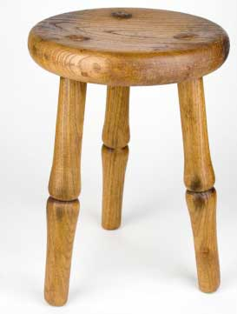
Changes Need to be…
Evidenced Based
Patient Centered
System Based

Slide 17

So How Do We Get Started?

Slide 18
Why Should I Care About Quality Improvement?
Improved patient outcomes
Improved patient safety
Increased customer satisfaction
Improved staff morale
Reduction of rework
Cost savings

Slide 19

And so…
Our approach to quality improvement in healthcare needs to be focused on identifying areas for change, creating change, and measuring change.

Slide 20
IHI Model for Improvement
What are we trying to accomplish?
How will we know that a change is an improvement?
What changes can we make that will result in an improvement?
Notes:
Nolan’s model--three questions and PDSA, but not just one PDSA. Difference between this and Juran is the emphasis on repeated PDSA cycles

Slide 21
Developing a Goal Statement
Where are we currently – why is this a problem?
  What does our data show?
  What is our trend?
Where do we want to be?
  What knowledge do we have?
  What is our goal?

Slide 22
QAPI: Using Knowledge to Improve
Improvement comes from the application of knowledge
Any approach to improvement must be based on building and applying knowledge
Significant, long-term, positive impact only occur when someone takes the initiative

Slide 23
Setting Goals
Be realistic
Be specific
Understanding CMS or Network-set goals vs. facility or corporate-set goals
Set both short term and long term
  In order to reach our long term goal, what do we need to accomplish monthly, quarterly, etc.
Remember “how to eat an elephant”

Slide 24
What Are We Trying to Accomplish?
Goal/Aim Statement
Our rate for catheters >90 days is 35%
KDOQI states that the 90 day catheter rate should be < 10%
We will have a 25% catheter rate in 6 months

Slide 25

How will we know a change is an improvement?
Collect and trend data
Identify sources of data
Review and trend data monthly
Analyze by various characteristics
Draw conclusions with the team

Slide 26
Data Sources
Data is NOT a four letter word!
Data is:
  Your observations – what you hear and what you see
  Your measurements – what you keep track of
  How you report your observations and measurements
What is the benchmark?
  What data sources do you have?

Slide 27
Your Observations – Subjective Data
Is there an opportunity for improvement?
  Too many catheters?
  Too many access infections?
  Patient safety issues?
Is there something that everyone is complaining about?
Is there a process that is too cumbersome?
  Medication errors?

Slide 28
Your Measurement – Objective Data
Begin to collect information about your problem, your observation
  Collect simple points of information at regular intervals over time
  KISS – counting the number of days between episodes of infections might be simpler and more meaningful that collecting every episode of access infection
  What is the trend?

Slide 29
How Will We Know a Change is an Improvement?
We will collect baseline 90 day catheter rates at the beginning of the project
We will collect 90 day catheter data each month and trend
We will collect 90 days catheter data at the end of 6 months to evaluate the success of the project: Our catheter rate will be 25% or less

Slide 30
What changes will result in an improvement: finding root causes
Don’t stop with surface issues – go deeper
Brainstorming to discover all root causes
  All disciplines – all team members
Use a root cause tool
  Fishbone diagram
  5 Whys
  Other tools

Slide 31
Root Cause Analysis
Medical
Surgical
Technical
Baseline
Desired Goal
Patient
Staff-Related
Education

Slide 33
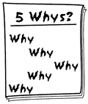
5 Whys
Why did this occur?
But why did that occur?
So why did that occur?
And then why did that occur?
OK, so then why did that occur?

Slide 34

What are the barriers?
What are the barriers to overcoming these root causes?
What barriers are within your control and what are not?

Slide 35
What are our root causes?
Problem: 35% of patients have catheters for more than 90 days
Goal: Decrease 90 day catheter rate to 25% in 6 months
Root cause(s): Difficulty in getting new accesses placed

Slide 36
Developing your QAPI Plan
Identify strategies
All team members need to have a role
Someone needs to be accountable and in charge
Tasks need to be assigned and dates set to re-evaluate
Plan needs to be dynamic – needs to be reviewed at least monthly

Slide 37
Developing your QAPI Plan
Act
ACT
Plan
State the objective
Do
DO
Study
STUDY
Develop a plan to carry out the cycle
PLAN
Carry out the plan
Document observations
Analyze the data
Complete analysis
Summarize what was learned
What changes are to be made?
What will be the next cycle?

Slide 40

Evaluate and Re-evaluate
Review plan regularly
Use data to determine – Are we improving?
Are we seeing unintended consequences?
Does the plan need revision?
Should we bring others to the team? If so, who is the best person to help?

Slide 41
What do you do at the end??
Evaluate!
  Did we achieve our overall goal?
  If not, why not?
  If so, make it a permanent change
  If not, what new strategies can we develop to try?
  Are there best practices we can adopt?
  Are there additional resources we need?
  Are there new partners we can bring to the team?

Slide 42

Resources

Slide 43



ESRD Network Resources
www.esrdnetworks.org

Slide 44
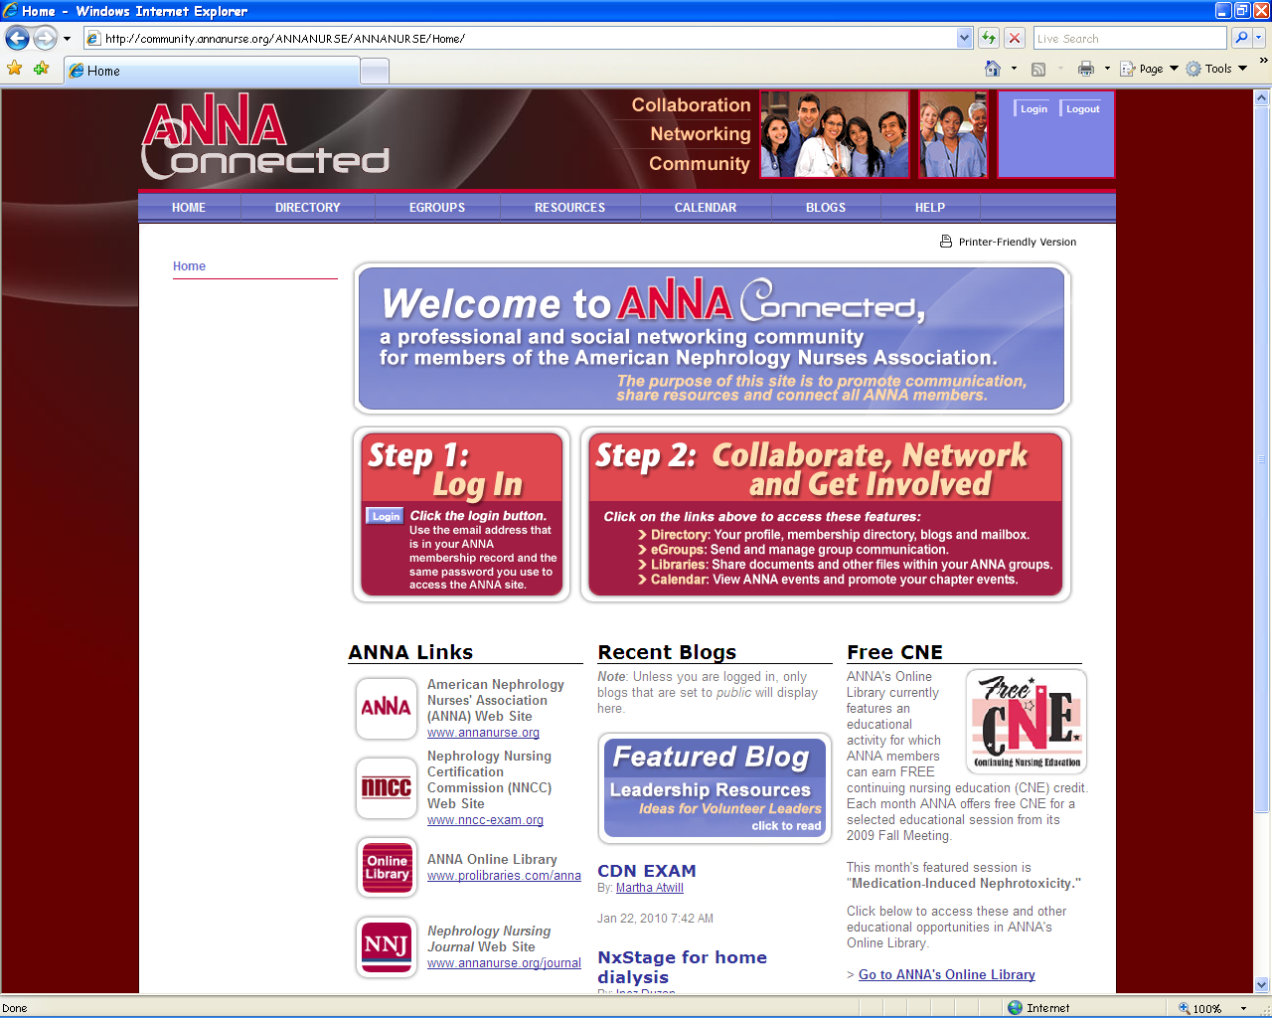


ANNA Resources
www.annanurse.org

Slide 45

Institute for Healthcare Improvement
www.ihi.org

Slide 46
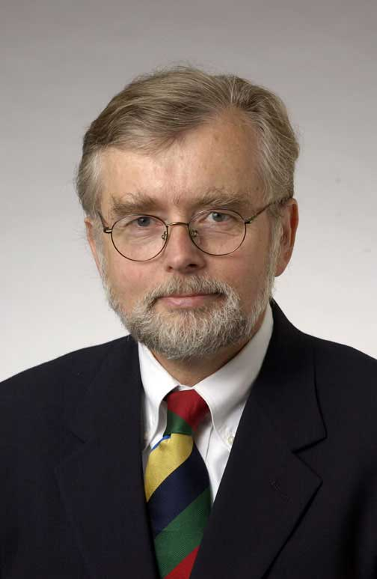
In Conclusion…
“Every system is perfectly designed to achieve the results that it gets.”
Paul Batalden

Slide 47

“The definition of insanity is doing the same thing over and over again and expecting different results”
Albert Einstein

Slide 48
Why Do QAPI?
Because CMS says so?
Because the Network is on my tail?
Because we won’t get paid if our outcomes are bad?
Because it’s the right thing to do – the right care for every patient every time!

Slide 49
Thank You!
Questions?

